Slide 1



lrd: An R Package and Shiny Application for Quickly Processing Lexical Response Data
Nicholas P. Maxwell¹, Mark J. Huff¹, & Erin M. Buchanan²
nicholas.maxwell@usm.edu | https://osf.io/admyx/

Slide 2
Introduction
Recall testing is commonly used to gauge memory retrieval
Coding responses can be time intensive and error prone
lrd (Lexical Response Data) is designed automate scoring of recall data
Cued-recall
Free recall
Sentence responses

Slide 3
Overview of Package
Three core functions:
prop_correct_cued()
prop_correct_free()
prop_correct_sentence()
Available at: https://github.com/npm27/lrd -- CRAN release coming soon!
To install: devtools::install_github(“npm27/lrd”)

Slide 4
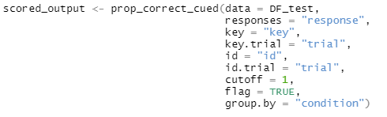
Cued-Recall
prop_correct_cued()
Response column

Slide 5
Cued-Recall
prop_correct_cued()
Response column
Answer key column

Slide 6
Cued-Recall
prop_correct_cued()
Response column
Answer key column
Item number for answer key

Slide 7
Cued-Recall
prop_correct_cued()
Response column
Answer Key column
Item number for answer key
Participant Identifier

Slide 8
Cued-Recall
prop_correct_cued()
Response column
Answer key column
Item number for answer key
Participant Identifier
Item number for study pairs

Slide 9
Cued-Recall
prop_correct_cued()
Response column
Answer key column
Item number for answer key
Participant Identifier
Item number for study pairs
Levenshtein Distance for scoring

Slide 10
Cued-Recall
prop_correct_cued()
Response column
Answer key column
Item number for answer key
Participant Identifier
Item number for study pairs
Levenshtein Distance for scoring
Flag Outliers? (± 3 sd)

Slide 11
Cued-Recall
prop_correct_cued()
Response column
Answer key column
Item number for answer key
Participant Identifier
Item number for study pairs
Levenshtein Distance for scoring
Flag Outliers? (± 3 sd)
Should output be grouped by condition?

Slide 12
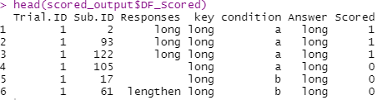
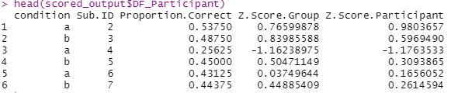
Cued-Recall
prop_correct_cued()

Slide 13
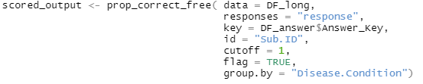
Free Recall
prop_correct_free()
Note: Data will need to be in long format!

Slide 14
Free Recall
prop_correct_free()
Note: Data will need to be in long format!
Answer key can be stored in a different dataframe.

Slide 15
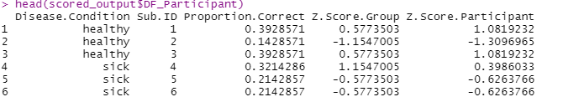
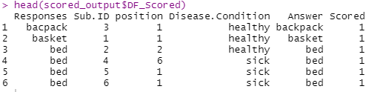
Free Recall
prop_correct_free()

Slide 16
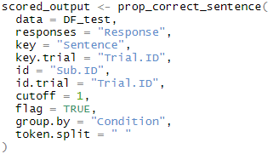
Sentences
prop_correct_sentence()
What separates words in each sentence?

Slide 17
Sentences
prop_correct_sentence()

Slide 18
Sentences
prop_correct_sentence()

Slide 19
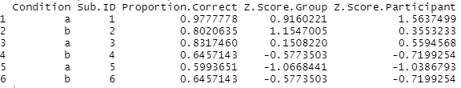
Sentences
prop_correct_sentence()

Slide 20
lrd Shiny Application
lrd is also available as an R Shiny application!
https://github.com/npm27/lrd/

